Slide 1

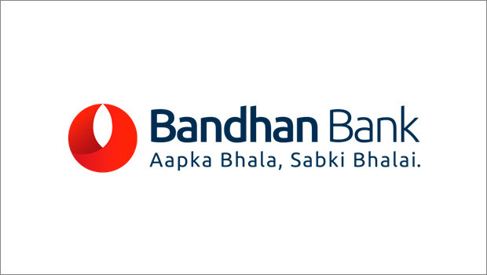
ADD TITLE
PRESENTED BY : RASHMI MITRA
PREPARED AS PER 2019-2020 DATA

Slide 2
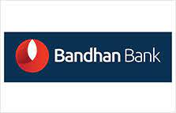
THE PAST ARCHIVES……
MR. CHANDRA SHEKHAR GHOSH: VISION AND MISSION
Bandhan Bank began its journey among women in rural West Bengal.
Mr. Chandra Shekhar Ghosh, founded Bandhan Financial Services in 2001 at a time when most established banks were wary about lending to small borrowers without credit history.
In 2009, Bandhan Bank was registered as a non-banking financial company providing select banking services.
In 2013, after a gap of over a decade, the Reserve Bank of India opened the counters for new banking licenses.
In April 2014, it was granted in-principle approval to start a bank.
Since then, its network has expanded from 501 branches and 50 ATMs to 840 branches and 383 ATMs across the country as of September 2017.

Slide 3
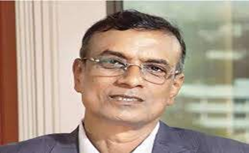
Mr. Chandra Shekhar ghosh: his journey from a bicycle to a Land Rover
Born in a village in Greater Tripura in 1960, Ghosh was the eldest of six siblings in a joint family of 15.
Ghosh sold milk and gave private tuitions to support himself.
After working with Village Welfare Society, a non-profit, in West Bengal , Ghosh gave wings to his idea to empower poor women microfinance.
He started his own company, Bandhan-Konnagar, in 2001 .
In 2009, he registered Bandhan as a non-banking finance company.

Slide 4

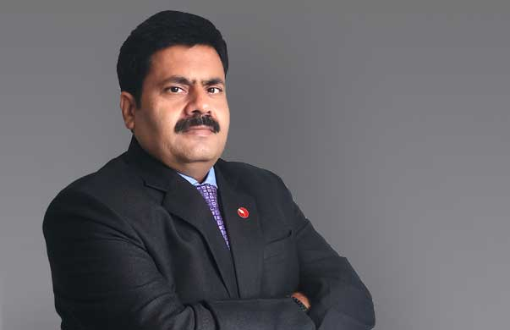
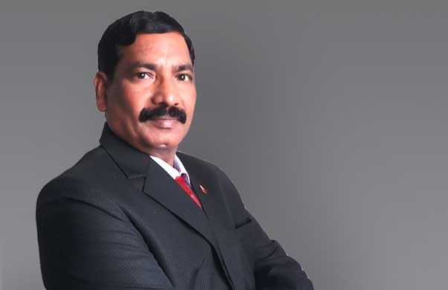

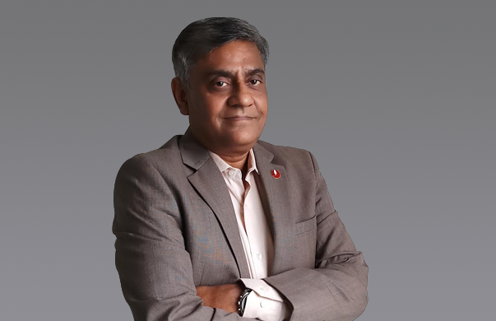
THE Board Of Directors
MR CHANDRA SHEKHAR GHOSH
FOUNDER, MD AND CEO
MR DEEPANKAR BOSE
HEAD OF CORPORATE CENTRE
MR SANJEEV NARYANI
HEAD OF BUSINESS
MR SANTANU BANERJEE
HEAD OF HR
MR SUNIL SAMDANI
CFO
MR SIDDHARTHA SANYAL
CHIEF ECONOMIST & RESEARCH
MR BISWAJIT DAS
CHIEF RISK OFFICER
MR S.J.RAO
LEGAL HEAD
MR NAND KUMAR SINGH
HEAD OF CUSTOMER SERVICE
MR SRINIVASAN BALACHANDER
CHIEF COMPLIANCE OFFICER

Slide 5
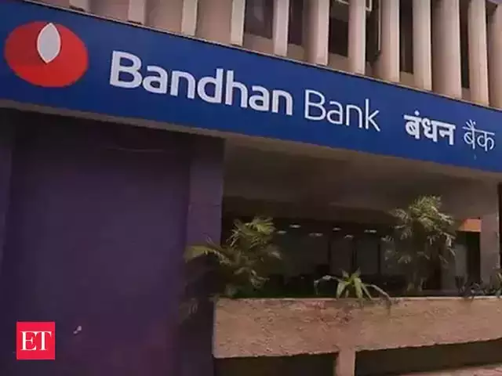



Headquarters AND HEAD OFFICE
Bandhan Bank Ltd. is an Indian banking and financial services company headquartered in Kolkata, West Bengal.
Bandhan Bank Limited Head Office, Floors 12-14, Adventz Infinity@5, BN 5, Sector V, Salt Lake City, Kolkata - 700 091

Slide 6
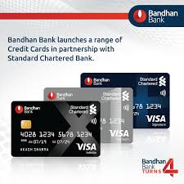
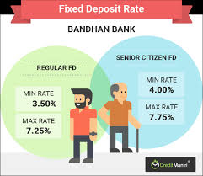
Products and services…
SAVINGS ACCOUNT: EASY SAVINGS AND ATTRACTIVE INTEREST…
Elite, Sanchay, Premium, Standard & Special savings scheme.
LOANS: STRENGTHEN FINANCIAL INCLUSIONS……
Home,Two-wheeler,Car,Personal,Gold,Msme,Agriculture,Small,Enterprise,Microloan.
DEPOSITS: ENJOY RETIREMENT AND LONG TERM GOALS…..
FD Premium, Super Saver, Dhan Samriddhi, Recurring Deposit.
CREDIT CARDS: DINE, SHOP AND HAVE FUN…..
One, Plus and Exclusive cards available
NRI BANKING: HOME IS WHERE THE HEART IS……

Slide 7


Key products of bandhan bank…
Bandhan Bank and HDFC Ergo health insurance have launched new product GAHP
- A day without insurance is like a day without sunshine.
Group Assurance Health Plan (GAHP). It is offered by HDFC Ergo Health Insurance Company Ltd in association with Bandhan Bank.
Who are eligible?
self/ family member(s), children, parents.
proposer above 18 years.
proposer age 46 years and above have to undergo medical test.
offers guaranteed lifetime renewability.
income tax benefits bought for self, spouse, parents and dependant children,

Slide 8
KEY FEATURES
Double sum insured for critical illness.
Double restore benefit.
Hospital daily cash.
E- Opinion in respect of critical illness.

Slide 9

BANDHAN BANK ACQUISITION- GRUH Home Loans.
- India Karega Grihapravesh.
Bandhan Bank acquired Gruh Finance from HDFC to strengthen its resolve towards
financial inclusion.
From GRUH finance to Gruh home loans.
It can construct and acquire new residential property, renovate, and loan against
property.
It aims to bring best product and service experience to the all the customers.

Slide 10
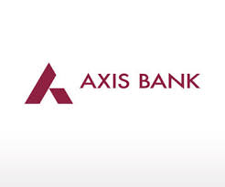
COMPETITORS
The 3 major competitors for Bandhan Bank(Stock price: BANDHAN BANK (NSE) ₹288.50 -2.40 (-0.83%)) are Axis Bank , City Union Bank and CSB bank.
Axis Bank Ltd: Stock price AXISBANK (NSE) ₹436.30 -11.80 (-2.63%)
Axis Bank is the third-largest private sector Indian bank, and offers a range of financial products.
The bank has its head office 2001 UTI Bank agreed to merge with Global Trust Bank, but the Reserve Bank of India (RBI) withheld approval and the merger did not happen.
In 2004, the RBI put Global Trust into moratorium and supervised its merger with Oriental Bank of Commerce. e in Mumbai, Maharashtra.
In 2009, Shikha Sharma was appointed as the MD and CEO of Axis Bank
As of 30 June 2016, 30.81% shares are owned by the promoters and the promoter group (United India Insurance Company Limited, Oriental Insurance Company Limited, National and Insurance Company Ltd

Slide 11


City Union Bank Ltd:Stock price: CUB (NSE) ₹121.25 +4.45 (+3.81%)
City Union Bank Limited (CUB) is an Indian bank headquartered in Kumbakonam, Tamil Nadu. The bank was initially named Kumbakonam Bank Limited, and was incorporated on 31 October 1904.
The bank preferred the role of a regional bank in the Thanjavur district of Tamil Nadu. CUB provides a gamut of technological services such as net banking and mobile banking, self-service kiosks
CSB Bank Ltd:Stock price: CSBBANK (NSE) ₹192.40 -0.30 (-0.16%)
CSB Bank Limited, formerly Catholic Syrian Bank Limited, is an Indian private sector bank with its headquarters at Thrissur, Kerala, India. It is one of the oldest banks in India.
CSB was founded on 26 November 1920,[4] well before Indian independence, and opened for business on 1 January 1921 with an authorized capital of 5 lakh rupees and a paid up capital of 45,270.

Slide 12
PIE CHART- MARKET SHARE
44% represents Bandhan Bank.
30% represents Axis Bank
17% represents City Union Bank
9% represents CAB Bank

Slide 13


